Slide 1
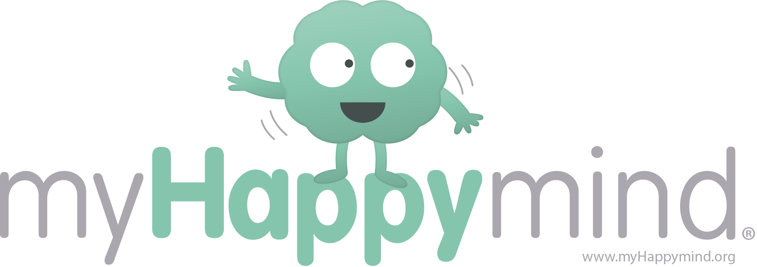
Meet your Brain
Part 1

Slide 2
Welcome to myHappymind!
Notes:
Welcome to myHappymind for parents – this is the first of 6 lessons designed to help you to understand what your child is learning in school and hopefully allow you to re-inforce the key points at home.
This 6 week course is made up of 6 lessons, these lessons mirror the modules that the children are learning at school.
You will have covered the whole curriculum in 6 weeks however, it will take longer for the children to get through this content and so you will likely be ahead of them! Your child’s teacher will be able to tell you where your child is up to.
Each lesson will cover the key points covered in school but we will try to make it fun too, we’ve also provided some exercises for you to work through her and to take home. We are going through more detail than your child may be exposed to but the terminology and characters remain the same!

Slide 3
Quiz time!
Notes:
This is Quincy, Quincy helps the children in school with myHappymind quiz’s!

Slide 4
What is my brain composed of?
Millions of cells called neurons
Blood and bones
No one really knows!
Notes:
<when you click on these in slideshow they will take you to another slide which says right or wrong – this only works in slideshow>

Slide 5
What does my brain help me with?
Moving my body
Making decisions
Everything that I do – thinking, speaking, moving etc.

Slide 6
Can our brain grow?
Your brain will always stay the same, your intelligence is fixed and you just have to learn to live with what you have got.
Your brain can grow and change if you work hard and focus. Your intelligence can grow if you put effort into learning and challenging yourself.

Slide 7
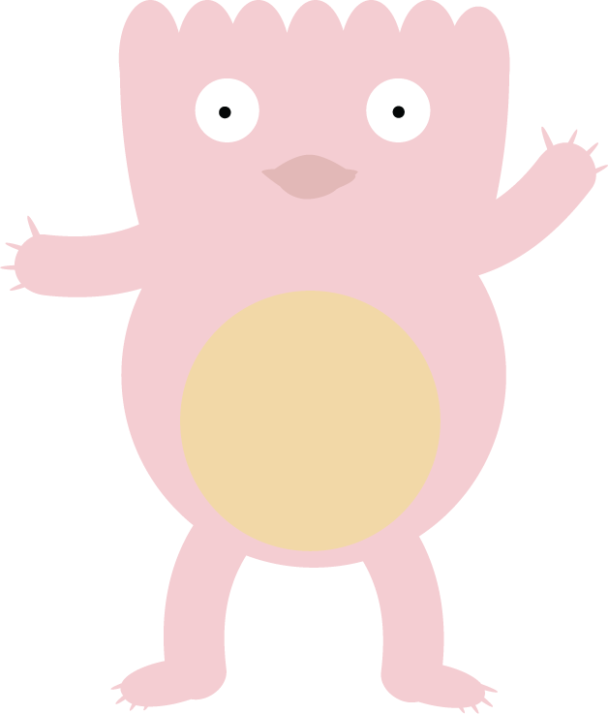
That’s right – well done!

Slide 8
Not quite – try again!

Slide 9
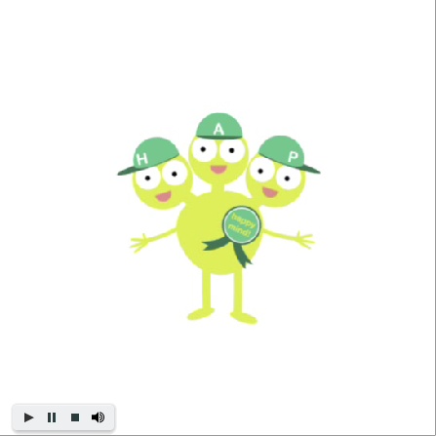
So how does our brain work?
The three most important parts of your brain are your:
Hippocampus
Amygdala
Prefrontal Cortex
We like to call them Team H-A-P!
They work best when they are working in a team.
Play the video to listen to the correct pronunciation of these words!
Notes:
OK, so now that we have warmed ourselves up and started to think about our brain, let’s learn a little more about how our brain works.

Slide 10
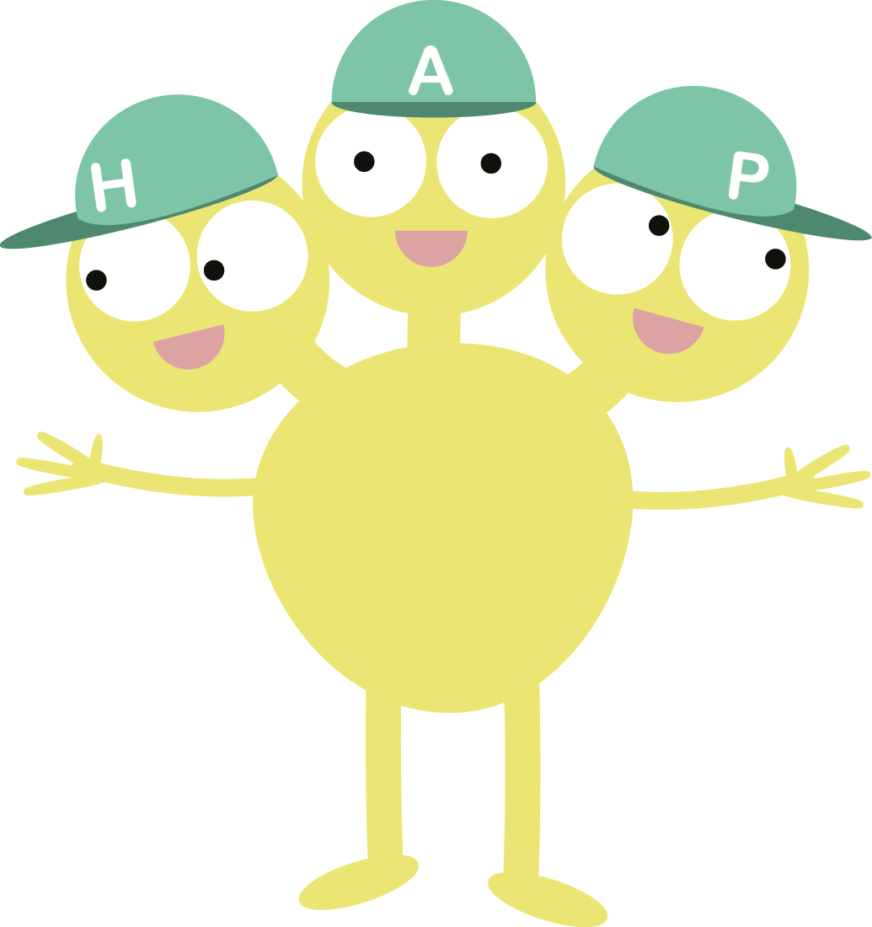
Hippocampus
H for Hippocampus
Your Hippocampus is responsible for storing memories and learning. It also attaches emotions to memories.
When your brain recalls a memory, it will also recall the emotion that you experienced with that memory.
For example, I was so happy when we went to the beach last summer. Or, I was so scared when I went on that roller-coaster.
Notes:
OK, so now that we have warmed ourselves up and started to think about our brain, let’s learn a little more about how our brain works.
ACTIVITY – have a go at thinking of some examples of when your Hippocampus has been active today in tables and then share examples.

Slide 11
Amygdala
A for Amygdala
The Amygdala helps us to react to fear, danger or threat.
It is like our brain’s security guard watching out at all times to keep us safe from any potential danger.
If the Amygdala senses danger then it reacts be either Fighting, Flighting or Freezing!
Sometimes our Amygdala reacts because it thinks there is danger when really there isn’t.
This is because it cannot respond or assess whether the danger is real or not, it only reacts!
Notes:
Use the example of a car coming towards you and your instinct being to run away, this is your amygdala keeping you safe by forcing you to run or flight.
ACTIVITY – have a go at thinking of some examples of when your Amygdala has been active today or recently in tables and then share examples.

Slide 12
Prefrontal Cortex
P for Prefrontal Cortex
The Prefrontal cortex is the reasoning and thinking part of the brain.
It helps you to concentrate, solve problems, make decisions, predict, analyze, write as well as lots of other things!
The prefrontal cortex is located at the front of your brain just behind your forehead.
It plays a key role in assessing situations and then helping you to take a decision on the right path forward.
Notes:
OK, so now that we have warmed ourselves up and started to think about our brain, let’s learn a little more about how our brain works.
ACTIVITY – have a go at thinking of some examples of when your Prefrontal cortex has been active today in tables and then share examples.

Slide 13
How do Team H-A-P work together?
Team H-A-P work best when information can flow between the Hippocampus, the Amygdala and the Prefrontal cortex.
If Team H-A-P can ‘talk’ to each-other then they can analyze situations, recall previous memories and learning and then respond.
This allows them to have the best chance at making a good decision and be at their best.
The key thing that determines whether Team H-A-P work well together or not is, our emotional state or, how we are feeling.
Let’s explore what happens in different scenarios and why.

Slide 14
When we are feeling happy, safe and calm
The Amygdala plays a key role in determining our emotional response. It does this by analyzing sensory inputs or, things that we see, hear, taste, smell or feel.
When it is calm, it can efficiently pass information to the Hippocampus and Prefrontal cortex and we are able to make decisions about how to respond appropriately.
Notes:
Great to bring this to life with an example if possible perhaps share an example of how your brain has worked well together giving examples of each of the roles of Team H-A-P. Try and get the tables sharing their thoughts too.
Remember to click play on the video!

Slide 15
When we are sad, scared or worried
When the Amygdala detects a sensory input that it associates with danger it reacts differently.
The Amygdala will shut down the information flow to the Hippocampus and Prefrontal cortex and react: Fight, Flight or Freeze.
Until the Amygdala perceives the danger to have gone, the Hippocampus and Prefrontal cortex will remain shut down.
This means, when the Amygdala has taken over we cannot respond, we can only react.
Notes:
Great to bring this to life with an example if possible perhaps share an example of how your brain has not worked well giving examples of each of the roles of Team H-A-P. Try and get the tables sharing their thoughts too.
Remember to play the video

Slide 16
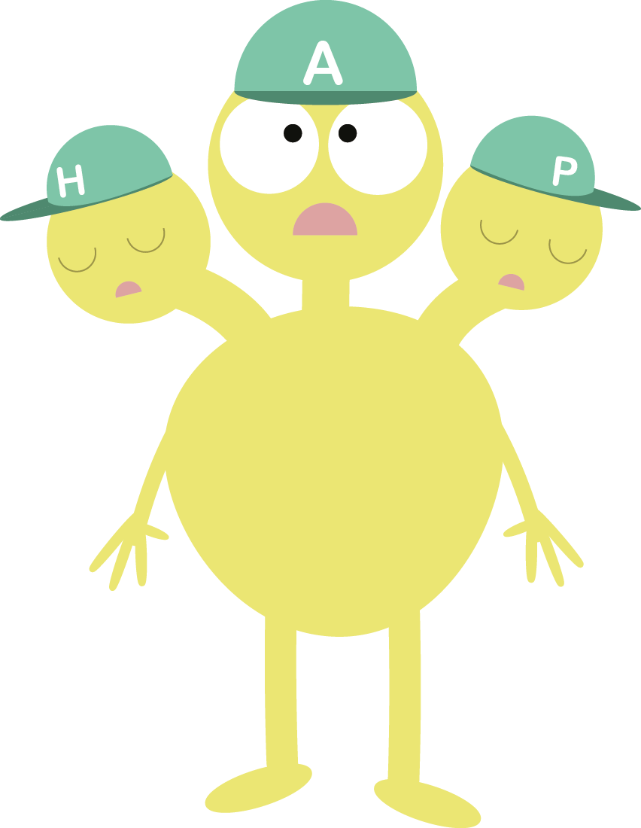
Managing your Amygdala
I’m all on my own here!
When your Amygdala senses danger, it quickly sends the oxygen from your brain to your arms, legs and torso ready to Fight, Flight or Freeze.
It does this whether the danger is real or just perceived.
Can you think of some examples of real vs perceived danger?
Notes:
Examples really bring this to life, for their children it could be speaking in an assembly, taking a test etc

Slide 17
Managing your Amygdala
When the Amygdala has reacted and taken over our brain our Hippocampus and Prefrontal Cortex effectively shut down. This means we can’t engage them for decision making or to recall memories.
This is actually very helpful when the danger is real as it allows us to focus entirely on keeping safe.
But when the danger isn’t real the Amygdala can be really unhelpful!
To help calm the Amygdala down, we need to get oxygen back to your brain so that Team H-A-P can work together again.
All I can do is fight, flight or freeze!

Slide 18
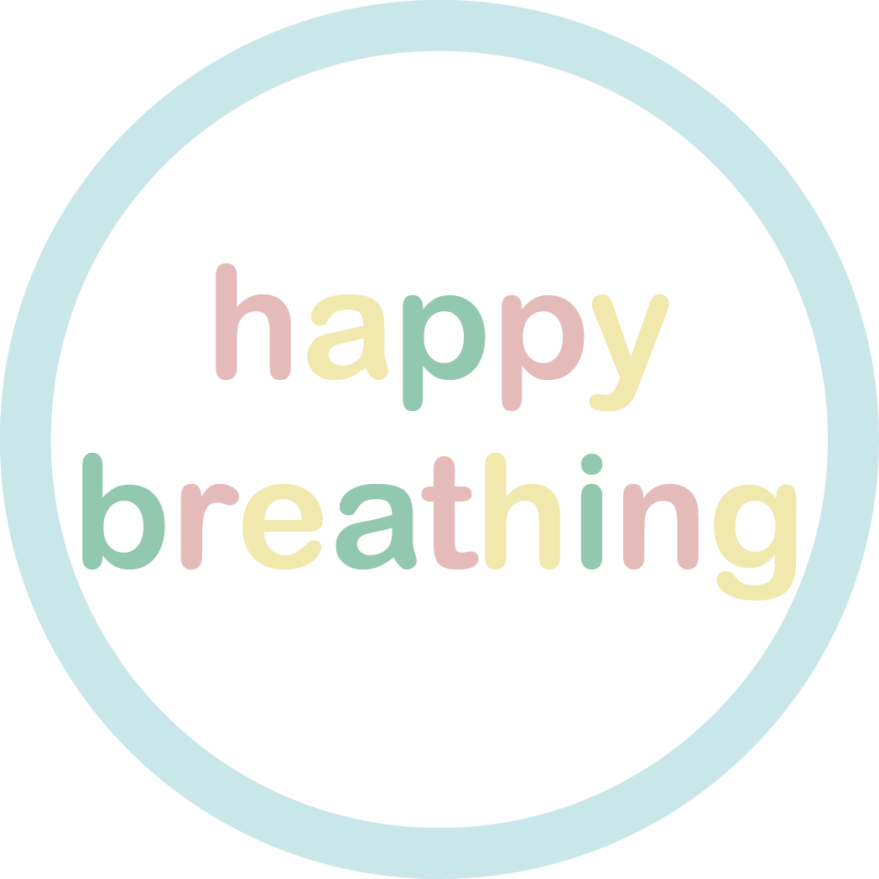
Happy breathing can help!
When we do happy breathing, our lungs are filled with oxygen which they send back to the brain. This helps our Hippocampus and Prefrontal cortex wake up again if our Amygdala has taken over.
Happy breathing can also help us even when our Amygdala has taken over.
There are lots of ways to practice your happy breathing. Let’s try now with a guided practice that means, you focus on someone voice and follow their instructions.
When our Amygdala has taken over and the danger isn’t real, we need to learn how to calm it down. Happy breathing can help us with that.
When we do happy breathing, our lungs are filled with oxygen which, they send back to the brain. This helps our Hippocampus and Prefrontal cortex to wake up again so we can recall memories and make rational decisions.
Let’s practice some happy breathing now
Notes:
Remind everyone that its ok not to shut eyes if don't want to.
Click on the audio next to the happy breathing button

Slide 19
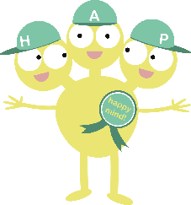
Managing your Amygdala
When you practice happy breathing your brain learns to respond better in stressful situations. Over time, your Amygdala will react less when there isn’t any real danger.
Happy breathing can also help you if you are worried about an event or an activity.
Try happy breathing before whatever you may be worried about and it will help you feel calmer.
You can access happy breathing exercises for FREE via the myHappymind app on the App store now.
We love happy breathing !

Slide 20
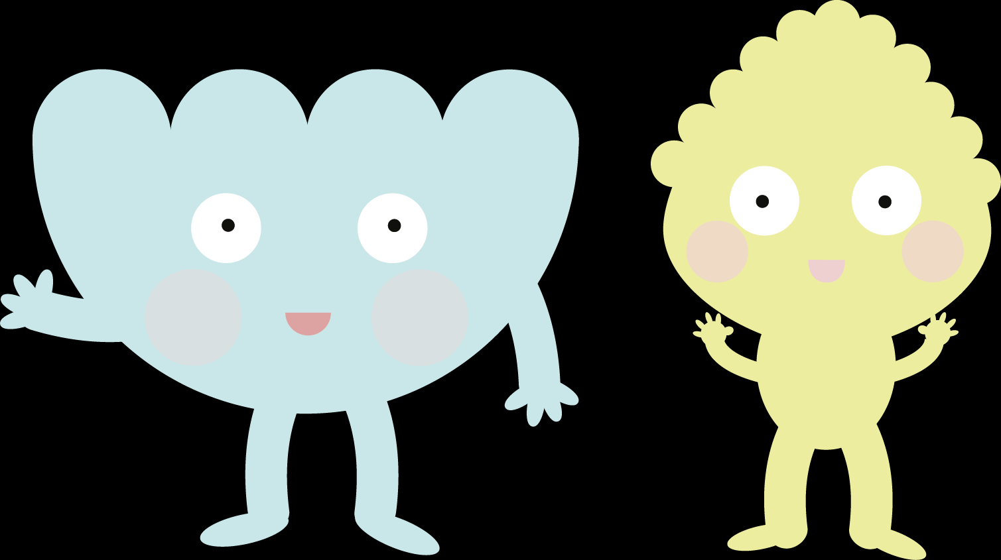
Summary
When we do happy breathing, our lungs are filled with oxygen which they send back to the brain. This helps our Hippocampus and Prefrontal cortex wake up again if our Amygdala has taken over.
Happy breathing can also help us even when our Amygdala has taken over.
There are lots of ways to practice your happy breathing. Let’s try now with a guided practice that means, you focus on someone voice and follow their instructions.
The key concepts you have learnt today are ones that children will be learning over the myHappymind curriculum.
We would now like you to complete the workbook we have provided to help you think about how you could embed some of what you have learnt at home.
You can also use this time to ask any questions that you may have.

Slide 21
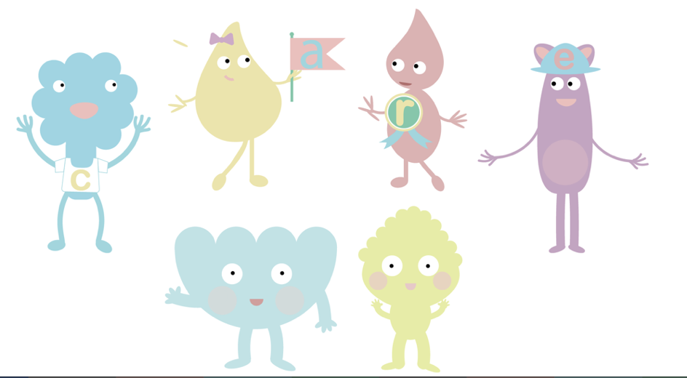
Questions?
When we do happy breathing, our lungs are filled with oxygen which they send back to the brain. This helps our Hippocampus and Prefrontal cortex wake up again if our Amygdala has taken over.
Happy breathing can also help us even when our Amygdala has taken over.
There are lots of ways to practice your happy breathing. Let’s try now with a guided practice that means, you focus on someone voice and follow their instructions.
Notes:
Encourage them to talk to partner and think about how that felt, dont ask then to share

Slide 22
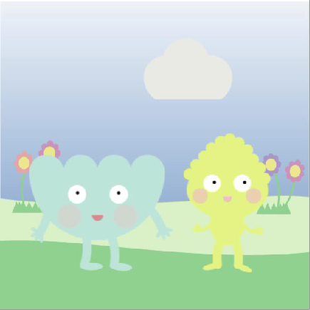
Coming up next!
r happy breathing. Let’s try now with a guided practice that means, you focus on someone voice and follow their instructions.
Meet Your Brain Part 2 – Learning about habits and how your brain grows!

